Slide 1

Deep Learning Specialization by deeplearning.ai
Course 1- Neural Networks and Deep Learning
Week 1- Introduction to Deep Learning
AI is the new Electricity
Electricity had once transformed countless industries: transportation, manufacturing, healthcare, communications and more.
AI will now bring about an equally big transformation
1.1. What is a neural network ?
Neural networks are a model inspired by how the brain works. Similar to neurons in the brain, our “mathematical neurons” are also, intuitively, connected to each other; they take inputs (dendrites), do some simple computation on them and produce outputs (axons).
Let us start with a simple neural network:

Slide 2
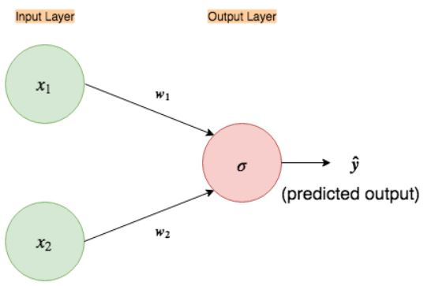
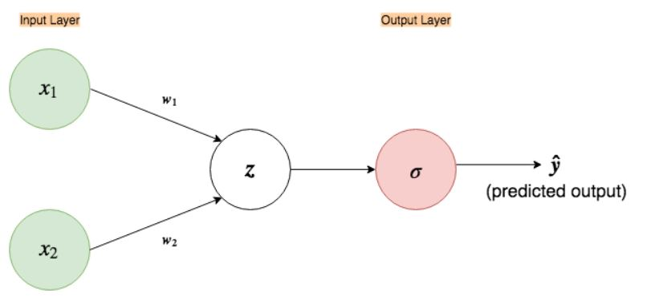
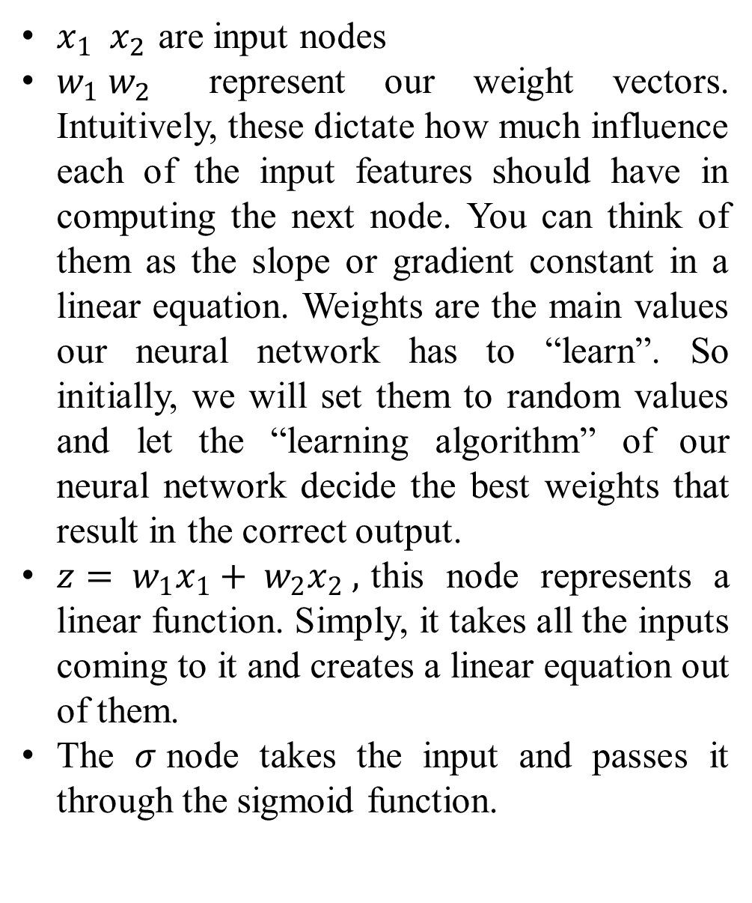
$x_{1} x_{2 }$are input nodes
$w_{1} w_{2}$ represent our weight vectors. Intuitively, these dictate how much influence each of the input features should have in computing the next node. You can think of them as the slope or gradient constant in a linear equation. Weights are the main values our neural network has to “learn”. So initially, we will set them to random values and let the “learning algorithm” of our neural network decide the best weights that result in the correct output.
$z= w_{1}x_{1}+ w_{2}x_{2} ,$this node represents a linear function. Simply, it takes all the inputs coming to it and creates a linear equation out of them.
The $σ$node takes the input and passes it through the sigmoid function.
Fig 1. Simple input - output only neural network
Fig 2. Expanded neural network

Slide 3
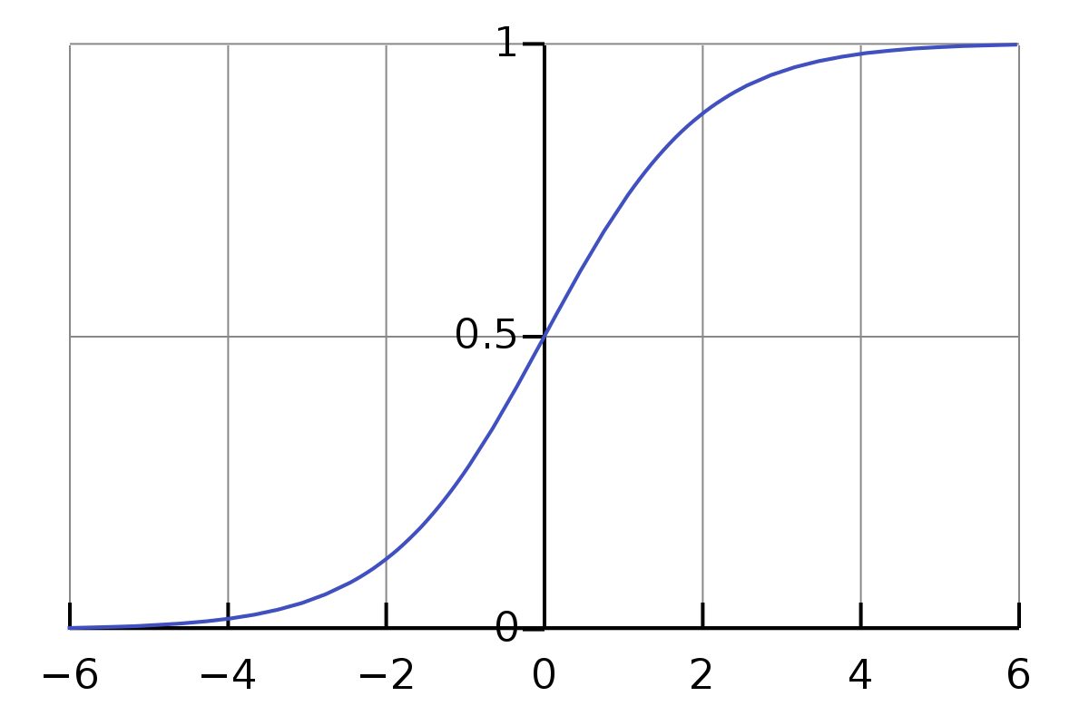
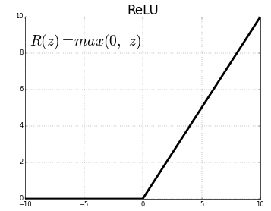
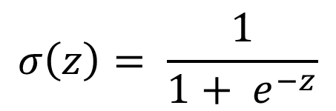
$$σ\left(z\right)= \frac{1}{1+ e^{−z}}$$
Fig 3. Sigmoid activation function
Sigmoid is one of the many “activations functions” used in neural network. The job of an activation function is to change the input to a different range. For example, if z > 2 then, σ(z) ≈ 1 and similarly, if z < -2 then, σ(z) ≈ 0.
ReLU stands for Rectified Linear Unit is another type of activation function. It is the most commonly activation function in neural networks, especially in CNNS.
By switching from the sigmoid function to the ReLU function, we help the gradient descent run much faster.
Fig4. ReLU activation function

Slide 4
1.2. Supervised Learning with Neural Networks
Input (x) | Output (y) | Application | DL Algorithm
Home features | Price | Real estate | Standard Neural Network
Ad, user info | Click on ad? (0/1) | Online advertising | Standard Neural Network
Image | Object (1,.……, 1000) | Photo tagging | Convolutional Neural Network
Audio | Text transcript | Speech recognition | Recurrent Neural Network
English | Chinese | Machine translation | Recurrent Neural Network
Image, Radar Info | Position of other cars | Autonomous driving | Cluster/ Hybrid
Structured data: organized data in a table (excel sheet)
Unstructured data: audio, images, text, here the features might be the pixel values in an image or the individual words in a piece of text.

Slide 5
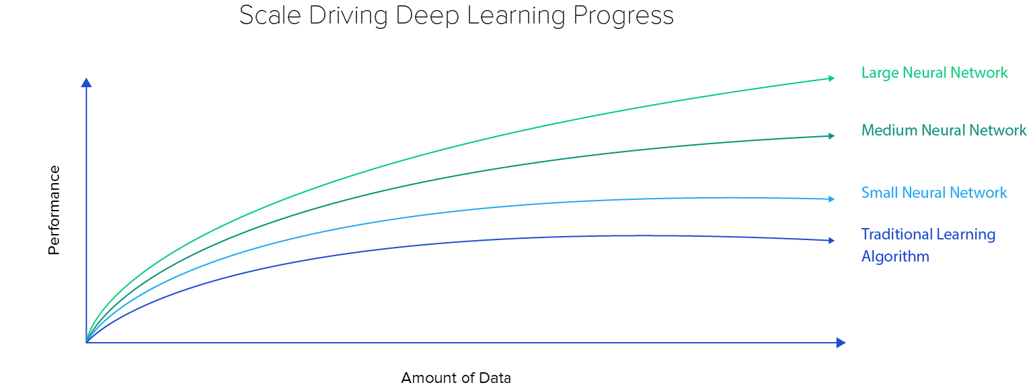
1.3. Why is Deep Learning taking off?
Deep Learning is taking off due to a large amount of data available through the digitization of the society, faster computation and innovation in the development of neural network algorithm.
The sources of data can be digital devices, inexpensive cameras, sensors in IoT
High Performance = Large NN (large amount of units, parameters, lot of connections) + Large amount of data

Slide 6
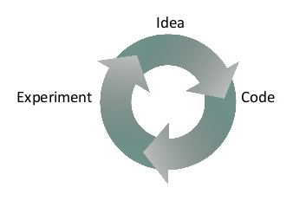
This loop explains the second reason why we need fact computation.
Week 2- Neural Networks Basics
2.1. Binary Classification
Logistic regression is an algorithm for binary classification.
If we input an image, it outputs 1 (cat) vs 0 (non cat).
An image stored in a computer = 3 layers of pixels corresponding to the RGB color channels of this image.
If we have 64x64 image then we have 3 64x64 matrices corresponding to the red, green, blue pixel intensity values for you image.
To unroll all these pixels intensity values into Feature vector:

Slide 7
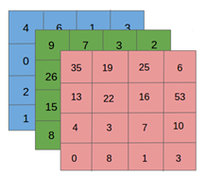
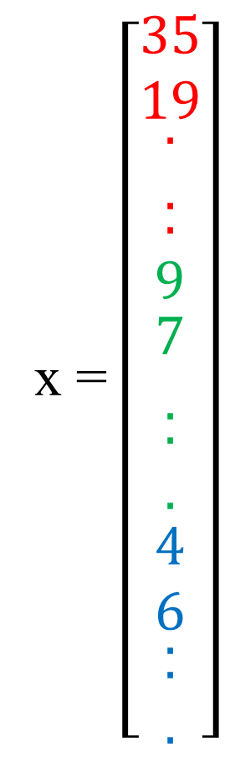
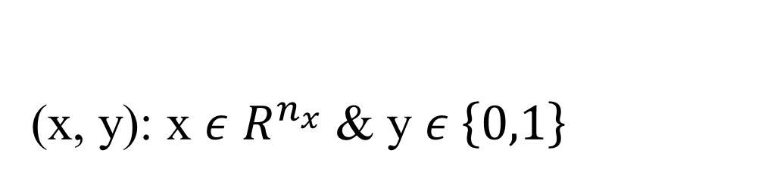

(x, y): x $ε$ $R^{n_{x}}$ & y $ε \left\{0,1\right\}$
x = $\left[\begin{matrix}35 \\ 19 \\ \begin{matrix}. \\ . \\ \begin{matrix}. \\ 9 \\ \begin{matrix}7 \\ . \\ \begin{matrix}. \\ . \\ \begin{matrix}4 \\ 6 \\ \begin{matrix}. \\ \begin{matrix}. \\ .\end{matrix}\end{matrix}\end{matrix}\end{matrix}\end{matrix}\end{matrix}\end{matrix}\end{matrix}\right]$
The dimension of the input feature x is :
$n_{x}=64 x 64 x 3=12288$

Slide 8
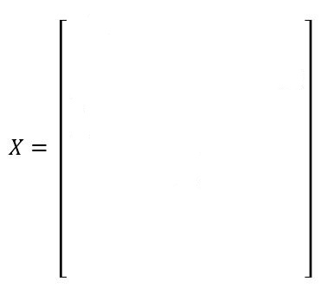



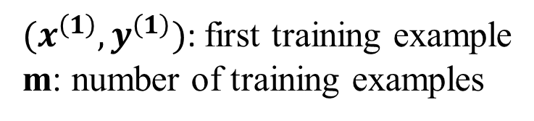

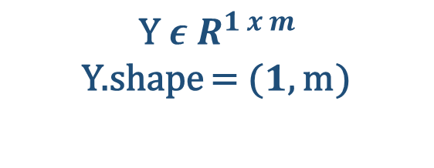

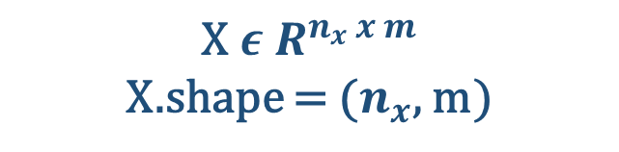
Notation
$$Y= \left[\begin{matrix}y^{\left(1\right)} & \begin{matrix}… & … & …\end{matrix} & y^{\left(m\right)}\end{matrix}\right]$$
$${\text{Y} ε R}^{1 x m}$$
Y.shape = ($1$, m)
$$X^{\left(1\right)}$$
$$X^{\left(2\right)}$$
………
$$X^{\left(m\right)}$$
$$n_{x}$$
$(x^{\left(1\right)}, y^{\left(1\right)})$: first training example
m: number of training examples
$$m$$
$${\text{X} ε R}^{n_{x} x m}$$
X.shape = ($n_{x}$, m)

Slide 9

2.2. Logistic Regression
Given x, want $\hat{y}=P\left(y=1 | x\right) 0≤\hat{y }≤1$
$${\text{x} ε R}^{n_{x} }$$
Parameters: ${\text{w} ε R}^{n_{x} }$& $b ε R$
Output: $\hat{y}=σ(w^{T}x+b)$, ($z= w^{T}x+b)$
$σ\left(z\right)= \frac{1}{1+ e^{−z}}$
If z is large $σ\left(z\right)=\frac{1}{1+0}=1$
If z is small $σ\left(z\right)=\frac{1}{1+∞}≈0$

Slide 10
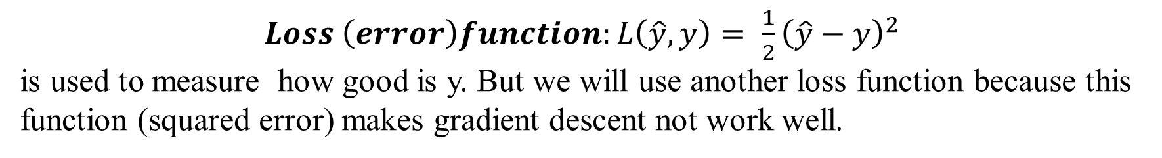
2.3. Logistic Regression Cost Function
To train the parameters w and b of the logistic regression model you need to define a cost function.
$${\hat{y}}^{(i)}=σ\left(w^{T}x^{\left(i\right)}+b\right) for the i^{th}training example$$
Training set
$$Given \left\{\left(x^{\left(1\right)},y^{\left(1\right)}\right), ……., \left(x^{\left(m\right)},y^{\left(m\right)}\right)\right\}, want {\hat{y}}^{\left(i\right)}≈ y^{\left(i\right)}$$
$Loss \left(error\right)function:L\left(\hat{y},y\right)= \frac{1}{2}{\left(\hat{y}−y\right)}^{2}$
is used to measure how good is y. But we will use another loss function because this
function (squared error) makes gradient descent not work well.
$$L\left(\hat{y},y\right)=−(y\log\left(\hat{y}\right)+\left(1−y\right)\log\left(1−\hat{y})\right)$$
We need to be as small as possible

Slide 11
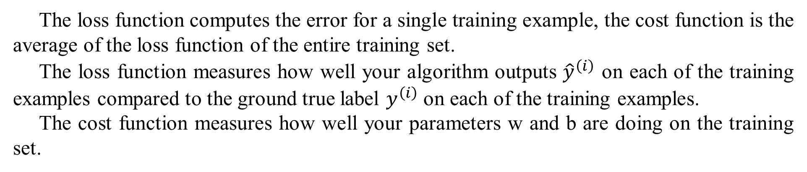
$$L\left(\hat{y},y\right)=−(y\log\left(\hat{y}\right)+\left(1−y\right)\log\left(1−\hat{y})\right)$$
$If y=1: L\left(\hat{y},y\right)=−\log\left(\hat{y}\right)$
$If y=0: L\left(\hat{y},y\right)=−\log\left(1 − \hat{y}\right)$
$Cost Function: J\left(w,b\right)= \frac{1}{m} \sum_{i=1}^{m}{L({\hat{y}}^{\left(i\right)},y^{\left(i\right)}})$= - $\frac{1}{m} \sum_{i=1}^{m}{(y\log\left(\hat{y}\right)+\left(1−y\right)\log\left(1−\hat{y})\right)}$
The loss function computes the error for a single training example, the cost function is the average of the loss function of the entire training set.
The loss function measures how well your algorithm outputs ${\hat{y}}^{\left(i\right)}$ on each of the training examples compared to the ground true label $y^{\left(i\right)}$ on each of the training examples.
The cost function measures how well your parameters w and b are doing on the training set.

Slide 12
2.4. Gradient Descent
The gradient descent algorithm is used to train or to learn, the parameters x and b on your training set.
Want to find w, b that minimize J(w, b)
Initial point on the graph J(w, b).
Gradient descent takes a step in the steepest downhill direction until finally converge to this global optimum.
More formally, gradient descent is an optimization algorithm used to minimize some function by iteratively moving the direction of the steepest descent as defined by the negative of the gradient. In neural networks, we use gradient descent to update the weights of our model.

Slide 13
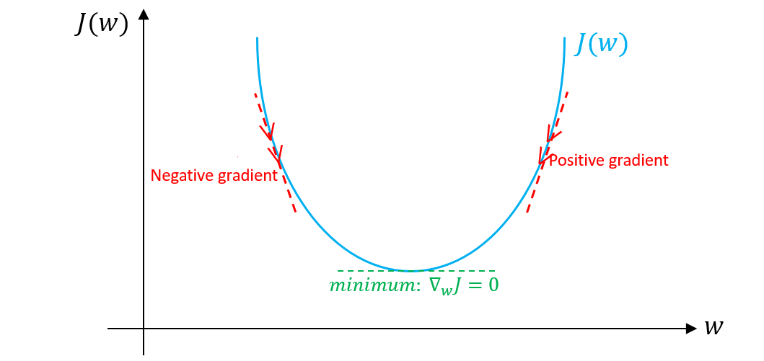
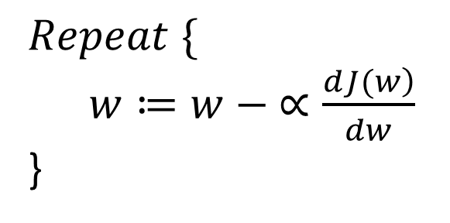
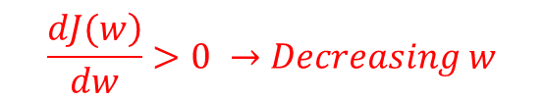

$$Repeat \{$$
$w≔w − ∝\frac{\left.dJ(w\right)}{dw}$
}
The change you want to make to the parameter w
Slope of the tangent on J(w)
Learning rate: it controls how big a step we take on each iteration or gradient descent
$$\frac{\left.dJ(w\right)}{dw}>0 →Decreasing w$$
$$\frac{\left.dJ(w\right)}{dw}<0 →Increasing w$$

Slide 14
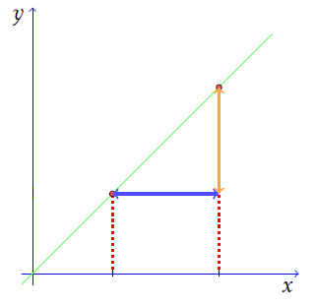

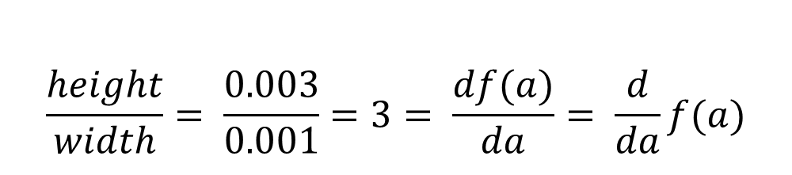

2.5. Intuition about derivatives
$$a=2 →f\left(a\right)=6$$
$$a=2.001 →f\left(a\right)=6.003$$
6.003
Slope (derivative) of f(a) at a = 2 is 3
0.003
$$\frac{height}{width}= \frac{0.003}{0.001}=3= \frac{df(a)}{da}= \frac{d}{da}f(a)$$
6
0.001
2
2.001

Slide 15
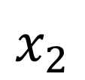

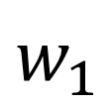
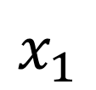
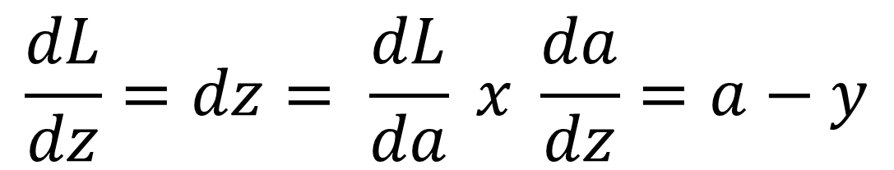

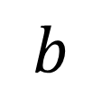

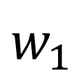
2.6. Logistic Regression Gradient Descent
$$x_{1}$$
$$w_{1}$$
$$x_{2}$$
$$z= w_{1}x_{1}+ w_{2}x_{2}+b$$
$$\hat{y}=a=σ\left(z\right)$$
$$L(a,y)$$
$$w_{1}$$
$$b$$
$$\frac{dL}{dz}=dz= \frac{dL}{da} x \frac{da}{dz}=a−y$$

Slide 16
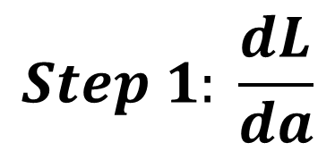
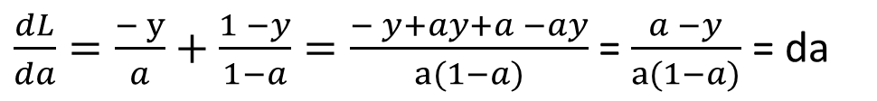
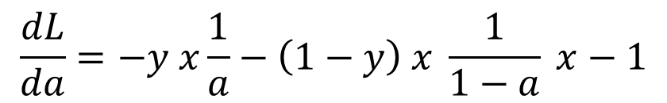
$$Step 1: \frac{dL}{da}$$
$$L=−(y\log\left(a\right)+\left(1−y\right)\log\left(1−a)\right)$$
$$\frac{dL}{da}=−y x\frac{1}{a}−\left(1−y\right) x \frac{1}{1−a} x−1$$
Remember that there is an additional -1 in the last term when we take the derivative of
(1 – a) with respect to a.
$\frac{dL}{da}=\frac{− y}{a}+\frac{1 −y}{1−a}=\frac{− y+ay+a −ay}{a(1−a)}$ = $\frac{a −y}{a(1−a)}$ = da

Slide 17
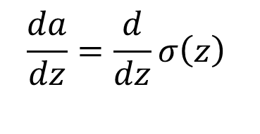
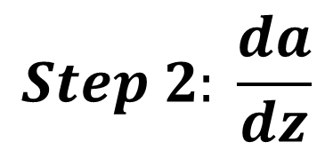
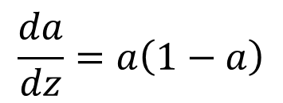
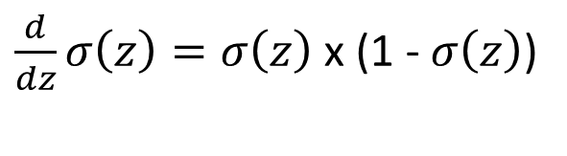
$$Step 2: \frac{da}{dz}$$
$$\frac{da}{dz}=\frac{d}{dz}σ\left(z\right)$$
The derivative of a sigmoid has the form:
$\frac{d}{dz}σ\left(z\right)=σ\left(z\right)$ x (1 - $σ\left(z\right)$)
Recall that $σ\left(z\right)$ = a, because we defined “a”, the activation, as the output of the sigmoid activation function.
$$\frac{da}{dz}=a\left(1−a\right)$$

Slide 18

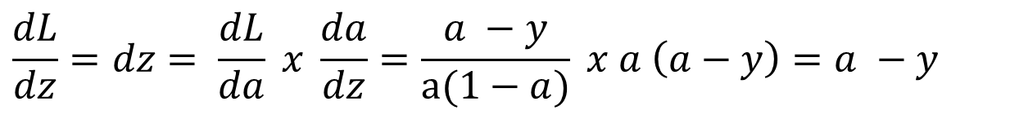

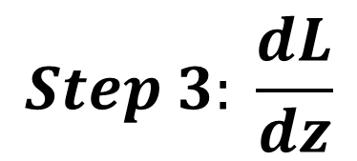
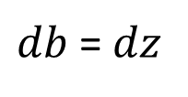
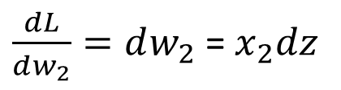
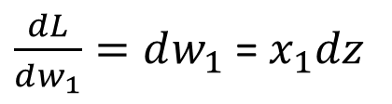

$$Step 3: \frac{dL}{dz}$$
$$\frac{dL}{dz}=dz= \frac{dL}{da} x \frac{da}{dz}=\frac{a −y}{a(1−a)} x a \left(a−y\right)=a −y$$
$\frac{dL}{dw_{1}}=dw_{1}$ = $x_{1}dz$
$$w_{1}≔w_{1}− ∝dw_{1}$$
$\frac{dL}{dw_{2}}=dw_{2}$ = $x_{2}dz$
$$w_{2}≔w_{2}− ∝dw_{2}$$
$db$ = $dz$
$$b≔b − ∝db$$

Slide 19
2.7. Vectorization
import numpy as np a = np.array([1,2,3,4]) print(a) import time a = np.random.rand(1000000) b = np.random.rand(1000000) tic = time.time() c = np.dot(a,b) toc = time.time() print("Vectorized version:" + str(1000*(toc -tic)) + "ms")
Vectorized version: 0.9982585906982422 ms

Slide 20
import numpy as np a = np.array([1,2,3,4]) print(a) import time c = 0 a = np.random.rand(1000000) b = np.random.rand(1000000) tic = time.time() for i in range(1000000): c += a[i]*b[i] toc = time.time() print("For Loop" + str(1000*(toc -tic)) + "ms")
For Loop 622.3413944244385 ms
We can conclude that the vectorised implementation (for loop) made the computation much faster. So whenever possible, avoid explicit for loops.

Slide 21
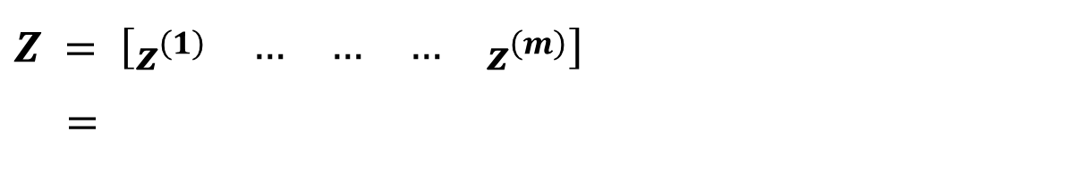





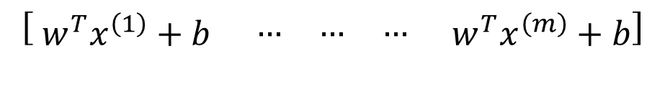

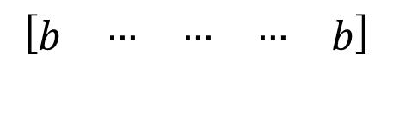


2.7. Vectorising Logistic Regression
$${z^{(1)}= w}^{T}x^{\left(1\right)}+b$$
$${z^{(2)}= w}^{T}x^{\left(2\right)}+b$$
$${z^{(3)}= w}^{T}x^{\left(3\right)}+b$$
$$a^{(1)}=σ(z^{\left(1\right)})$$
$$a^{(2)}=σ(z^{\left(2\right)})$$
$$a^{(3)}=σ(z^{\left(3\right)})$$
1 x m
$Z = \left[\begin{matrix}z^{\left(1\right)} & \begin{matrix}… & … & …\end{matrix} & z^{\left(m\right)}\end{matrix}\right]$
=
$$w^{T}X+$$
$$\left[\begin{matrix}b & \begin{matrix}… & … & …\end{matrix} & b\end{matrix}\right]$$
=
$$\left[\begin{matrix}{ w}^{T}x^{\left(1\right)}+b & \begin{matrix}… & … & …\end{matrix} & { w}^{T}x^{\left(m\right)}+b\end{matrix}\right]$$
In Python: Z = np.dot (W.T, X) + b
$$A= \left[\begin{matrix}a^{\left(1\right)} & \begin{matrix}… & … & …\end{matrix} & a^{\left(m\right)}\end{matrix}\right]=σ(Z)$$

Slide 22
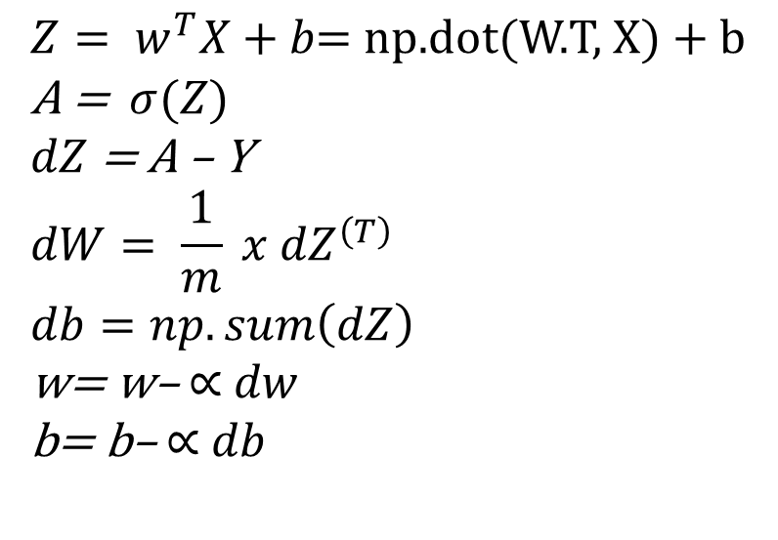





2.8. Vectorising Logistic Regression’s Gradient Computation
$${{dz}^{(1)}=a}^{(1)} − y^{(1)}$$
$${{dz}^{(2)}=a}^{(2)} − y^{(2)}$$
$$A= \left[\begin{matrix}a^{\left(1\right)} & \begin{matrix}… & … & …\end{matrix} & a^{\left(m\right)}\end{matrix}\right]$$
$$Y= \left[\begin{matrix}y^{\left(1\right)} & \begin{matrix}… & … & …\end{matrix} & y^{\left(m\right)}\end{matrix}\right]$$
1 x m
$$dZ= \left[\begin{matrix}{dz}^{\left(1\right)} & \begin{matrix}… & … & …\end{matrix} & {dz}^{\left(m\right)}\end{matrix}\right]$$
$$= \left[\begin{matrix}a^{(1)} − y^{(1)} & \begin{matrix}… & … & …\end{matrix} & a^{(m)} − y^{(m)}\end{matrix}\right]$$
Vectorized Implementation
$${Z= w}^{T}X+b\text{= }\text{np}\text{.}\text{dot}\text{(}\text{W}\text{.}\text{T}\text{, }\text{X}\text{) + }\text{b}$$
A = $σ(Z)$
$dZ$ = A – Y
$$dW= \frac{1}{m} x {dZ}^{\left(T\right)}$$
$$db=np.sum\left(dZ\right)$$
w= w– $∝$ $dw$
b= b– $∝$ $db$

Slide 23
2.9. Broadcasting in Python
The term broadcasting describes how NumPy treats arrays with different shapes during arithmetic operations. Subject to certain constraints, the smaller array is “broadcast” across the larger array so that they have compatible shapes. Broadcasting provides a means of vectorising array operations so that looping occurs in C instead of Python. It does this without making needless copies of data and usually leads to efficient algorithm implementations.
NumPy operations are usually done on pairs of arrays on an element-by-element basis. In this simplest case, the two arrays must have exactly the same shape.
import numpy as np a = np.array([1,2,3]) b = np.array([2,2,2]) print(a*b)
[2 4 6]

Slide 24
NumPy’s broadcasting rule relaxes this constraint when the array’s shapes meet certain constraints. The simplest broadcasting example occurs when an array and a scalar value are combined in an operation:
import numpy as np a = np.array([1,2,3]) b = 2 print(a*b)
[2 4 6]
The result is equivalent to the previous example where b was an array. We can think of the scalar b being stretched during the arithmetic operation into an array with the same shape as a. The new elements in b are simply copies of the original scalar. The stretching analogy is only conceptual. NumPy is smart enough to use the original scalar value without actually making copies, so that broadcasting operations are as memory and computationally efficient as possible.

Slide 25
Assignment 1: Logistic Regression with a Neural Network mindset
You will build a logistic regression classifier to recognize cats. This assignment will step you through how to do this with a Neural Network mindset, and so will also hone your intuitions about deep learning.
You will learn to:
Build the general architecture of a learning algorithm, including:
Initializing parameters
Calculating the cost function and its gradient
Using an optimization algorithm (gradient descent)
Gather all three functions above into a main model function, in the right order.

Slide 26
1. Packages
The packages needed for this assignment are:
numpy is the fundamental package for scientific computing with python
h5py is a common package to interact with a dataset that is stored on an H5 file.
matplotlib is a famous library to plot graphs in Pyhton
PIL and scipy are used here to test your model with your own picture at the end
import numpy as np import matplotlib.pyplot as plt import h5py import scipy from PIL import Image from scipy import ndimage from lr_utils import load_dataset

Slide 27
2. Overview of the Problem set
Problem Statement: You are given a dataset (“data.h5”) containing:
A training set of m_train images labeled as cat (y = 1) or non-cat (y = 0)
A test set of m_test images labeled as cat or non-cat
Each image is of shape (num_px, num_px, 3) where 3 is for the 3 channels (RGB). Thus, each image is square (height = num_px) and (width = num_px)
# Loading the data (cat/non-cat) train_dataset = h5py.File('C:/Users/HP/Downloads/train_catvnoncat.h5', 'r') train_set_x_orig = np.array(train_dataset["train_set_x"][:]) train_set_y_orig = np.array(train_dataset["train_set_y"][:]) test_dataset = h5py.File('C:/Users/HP/Downloads/test_catvnoncat.h5', 'r') test_set_x_orig = np.array(test_dataset["test_set_x"][:]) test_set_y_orig = np.array(test_dataset["test_set_y"][:]) classes = np.array(test_dataset["list_classes"][:]) train_set_y = train_set_y_orig.reshape((1, train_set_y_orig.shape[0])) test_set_y = test_set_y_orig.reshape((1, test_set_y_orig.shape[0]))

Slide 28
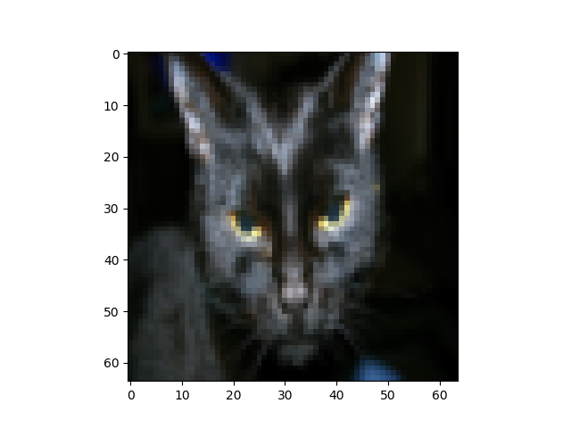
We added “_orig” at the end of image datasets (train and test) because we are going to preprocess them. After preprocessing, we will end up with train_set_x and test_set_x (the labels of train_set_y, and test_set_y do not need preprocessing)
# Example of a picture
index = 25 plt.imshow(train_set_x_orig[index]) print("y = " + str(train_set_y[:, index]) + " , it is a '"+
classes[np.squeeze(train_set_y[:,index])].decode("utf-8")+"'picture.")
y = [1] , it is a 'cat‘ picture.

Slide 29
Many software bugs in deep learning come from having matrix/vector dimensions that does not fit. If you can keep your matrix/vector dimensions straight you will go a long way toward eliminating many bugs.
m_train = train_set_x_orig.shape[0] m_test = test_set_x_orig.shape[0] num_px = train_set_x_orig.shape[1] print("Number of training examples: m_train = " + str(m_train)) print("Number of test examples: m_test = " + str(m_test)) print("Height/Width of each image: num_px = " + str(num_px))
Number of training examples: m_train = 209
Number of test examples: m_test = 50
Height/Width of each image: num_px = 64
For convenience, you should now reshape images of shape (num_px, num_px, 3) in a numpy array of shape (num_px*num_px*3, 1). After this, our training (and test) dataset is a numpy array where each column represents a flattened image. There should be m_train (respectively m_test) columns.

Slide 30
# Reshape the training and test examples train_set_x_flatten = train_set_x_orig.reshape(train_set_x_orig.shape[1]*train_set_x_orig.shape[1]*3 , -1) test_set_x_flatten = test_set_x_orig.reshape(test_set_x_orig.shape[1]*test_set_x_orig.shape[1]*3 , -1) print ("train_set_x_flatten shape: " + str(train_set_x_flatten.shape)) print ("train_set_y shape: " + str(train_set_y.shape)) print ("test_set_x_flatten shape: " + str(test_set_x_flatten.shape)) print ("test_set_y shape: " + str(test_set_y.shape)) print ("sanity check after reshaping: " + str(train_set_x_flatten[0:5,0]))
train_set_x_flatten shape: (12288, 209)
train_set_y shape: (1, 209)
test_set_x_flatten shape: (12288, 50)
test_set_y shape: (1, 50)
sanity check after reshaping: [17 71 49 38 70]

Slide 31
To represent color images, the red, green, and blue channels (RGB) must be specified for each pixel, and so the pixel value is actually a vector of three numbers ranging from 0 to 255.
One common preprocessing step in machine learning is to center and standardize your dataset, meaning that you subtract the mean of the whole numpy array from each example, and then divide each example by the standard deviation of the whole numpy array. But for pictures datasets, it is simpler and more convenient and works almost as well as to divide every row of the dataset by 255 (the maximum value of a pixel channel).
# Standardize our dataset train_set_x = train_set_x_flatten/255 test_set_x = test_set_x_flatten/255
You need to remember: common steps for pre-processing a new dataset are:
Figure out the dimensions and shapes of the problem (m_train, m_test, num_px,….)
Reshape the datasets such that each example is now a vector of size (num_px*num_px*3, 1).
Standardize the data

Slide 32
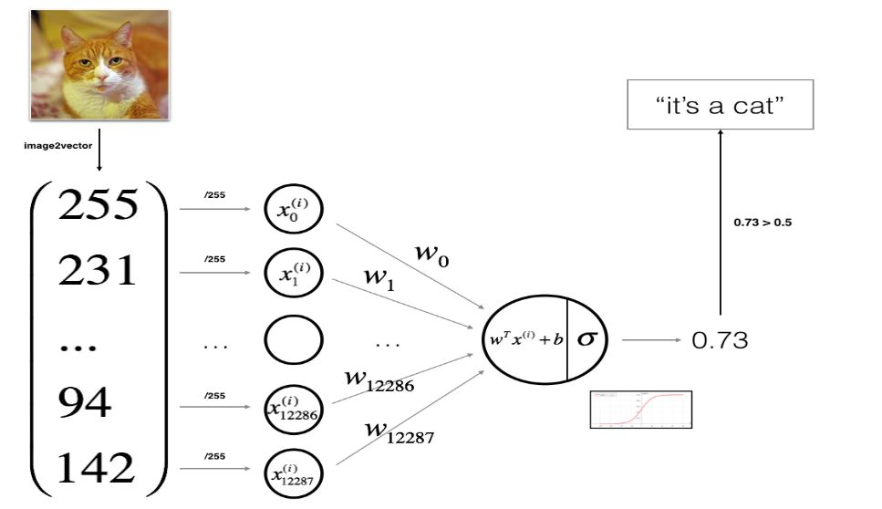
3. General Architecture of the learning algorithm

Slide 33


Slide 34
4. Building the parts
The main steps for building a Neural Network are:
Define the model structure (such as number of input features)
Initialize the model’s parameters
Loop:
Calculate current loss (forward propagation)
Calculate current gradient descent (backward propagation)
Update parameters (gradient descent)
You often build 1-3 separately and integrate them into one function we call model().

Slide 35
4.1. Helper functions
# sigmoid def sigmoid(z): s = 1. / (1. + np.exp(-z)) return s print("sigmoid([0,2]) = " + str(sigmoid(np.array([0,2]))))
sigmoid([0,2]) = [0.5 0.88079708]
4.2. Initializing parameters
This function creates a vector of zeros of shape (dim, 1) for w and initializes b to 0.
Argument:
dim -- size of the w vector we want (or number of parameters in this case)
Returns:
w -- initialized vector of shape (dim, 1)
b -- initialized scalar (corresponds to the bias)

Slide 36
# initialize_with_zeros def initialize_with_zeros(dim): w = np.zeros((dim, 1)) b = 0 assert (w.shape == (dim, 1)) assert (isinstance(b, float) or isinstance(b, int)) return w, b dim = 2 w, b = initialize_with_zeros(dim) print("w = " + str(w)) print("b = " + str(b))
w = [[0.]
[0.]]
b = 0

Slide 37

4.3. Forward and Backward propagation
Now that your parameters are initialized, you can do the “forward” and “backward” propagation steps for learning the parameters.

Slide 38
Implement the cost function and its gradient for the propagation explained above
Arguments:
w -- weights, a numpy array of size (num_px * num_px * 3, 1)
b -- bias, a scalar
X -- data of size (num_px * num_px * 3, number of examples)
Y -- true "label" vector (containing 0 if non-cat, 1 if cat) of size (1, number of examples)
Return:
cost -- negative log-likelihood cost for logistic regression
dw -- gradient of the loss with respect to w, thus same shape as w
db -- gradient of the loss with respect to b, thus same shape as b
Tips:
- Write your code step by step for the propagation. np.log(), np.dot()

Slide 39
# propagate def propagate(w,b, X, Y): m = X.shape[1] # Forward propagation (From X to COST) A = sigmoid(np.dot(w.T, X) + b) cost = -1/m * np.sum(np.dot(np.log(A), Y.T) + np.dot(np.log(1-A), (1-Y.T))) # Backward Propagation dw = 1/m*np.dot(X, (A-Y).T) db = 1/m*np.sum(A-Y) assert (dw.shape == w.shape) assert (db.dtype == float) cost = np.squeeze(cost) assert (cost.shape == ()) grads = {"dw" : dw, "db" : db} return grads, cost w, b, X, Y = np.array([[1.],[2.]]), 2., np.array([[1.,2.,-1.],[3.,4.,-3.2]]), np.array([[1,0,1]]) grads, cost = propagate(w, b, X, Y) print ("dw = " + str(grads["dw"])) print ("db = " + str(grads["db"])) print ("cost = " + str(cost))

Slide 40
dw = [[0.99845601]
[2.39507239]]
db = 0.001455578136784208
cost = 5.801545319394553
4.4. Optimization
You have initialized your parameters
You are also able to compute a cost function and its gradient
Now, you want to update the parameters using gradient descent

Slide 41
This function optimizes w and b by running a gradient descent algorithm
Arguments:
w -- weights, a numpy array of size (num_px * num_px * 3, 1)
b -- bias, a scalar
X -- data of shape (num_px * num_px * 3, number of examples)
Y -- true "label" vector (containing 0 if non-cat, 1 if cat), of shape (1, number of examples)
num_iterations -- number of iterations of the optimization loop
learning_rate -- learning rate of the gradient descent update rule
print_cost -- True to print the loss every 100 steps
Returns:
params -- dictionary containing the weights w and bias b
grads -- dictionary containing the gradients of the weights and bias with respect to the cost function
costs -- list of all the costs computed during the optimization, this will be used to plot the learning curve.
Tips:
You basically need to write down two steps and iterate through them:
1) Calculate the cost and the gradient for the current parameters. Use propagate().
2) Update the parameters using gradient descent rule for w and b.

Slide 42
def optimize (w, b, X, Y, num_iterations, learning_rate, print_cost = False): costs = [] for i in range(num_iterations): # cost and gradient calculation grads, cost = propagate(w, b, X, Y) # Retrieve the derivatives from grads dw = grads["dw"] db = grads["db"] # update rule w = w - learning_rate*dw b = b - learning_rate*db # Record the costs if i%100 == 0: costs.append(cost) # print the cost every 100 training iterations if print_cost and i%100 == 0: print("Cost after iteration %i: %f" %(i, cost))

Slide 43
params = {"w": w, "b": b} grads = {"dw": dw, "db": db} return params, grads, costs params, grads, costs = optimize(w, b, X, Y, num_iterations= 100, learning_rate = 0.009, print_cost = False) print ("w = " + str(params["w"])) print ("b = " + str(params["b"])) print ("dw = " + str(grads["dw"])) print ("db = " + str(grads["db"]))
w = [[0.19033591]
[0.12259159]]
b = 1.9253598300845747
dw = [[0.67752042]
[1.41625495]]
db = 0.21919450454067657

Slide 44
# predict def predict(w, b, X): m = X.shape[1] Y_prediction = np.zeros((1,m)) w = w.reshape(X.shape[0], 1) # compute vector A predicting the probabilities of a cat being present A = sigmoid(np.dot(w.T, X)+ b) for i in range(A.shape[1]): # convert probabilities A[0,i] to actual predictions p[0,i] Y_prediction = np.where(A > 0.5, 1, 0) assert(Y_prediction.shape == (1,m)) return Y_prediction w = np.array([[0.1124579], [0.23106775]]) b = -0.3 X = np.array([[1.,-1.1,-3.2],[1.2,2.,0.1]]) print("predictions = " + str(predict(w,b,X)))
predictions = [[1 1 0]]

Slide 45
5. Merge all into a model
You need to remember: you have implemented several functions that:
Initialize (w,b)
Optimize the loss iteratively to learn parameters (w,b):
Computing the cost and its gradient
Updating the parameters using gradient descent
Use the learned (w,b) to predict the labels for a given set of examples.
You will now see how the overall model is structured by outing together all the building blocks (functions implemented in the previous parts) together in the right order.

Slide 46
def model(X_train, Y_train, X_test, Y_test, num_iterations = 2000, learning_rate = 0.5, print_cost = False): # initialize parameters with zeros w, b = initialize_with_zeros(X_train.shape[0]) # Gradient descent parameters, grads, costs = optimize(w, b, X_train, Y_train, num_iterations, learning_rate, print_cost = True) # Retrieve parameters w and b from dictionary parameters w = parameters["w"] b = parameters["b"] # Predict test/train set examples Y_prediction_test = predict(w, b, X_test) Y_prediction_train = predict(w, b, X_train) # Print train/test Errors print("train accuracy:{} %".format(100 - np.mean(np.abs(Y_prediction_train - Y_train)) *100)) print("test accuracy:{} %".format(100 - np.mean(np.abs(Y_prediction_test - Y_test)) * 100))

Slide 47
d = {"costs": costs, "Y_prediction_test": Y_prediction_test, "Y_prediction_train": Y_prediction_train, "w": w, "b": b, "learning_rate": learning_rate, "num_iterations": num_iterations} return d d = model(train_set_x, train_set_y, test_set_x, test_set_y, num_iterations = 2000, learning_rate = 0.005, print_cost = True)
Cost after iteration 0: 0.693147
Cost after iteration 100: 0.709726
Cost after iteration 200: 0.657712
Cost after iteration 1800: 0.338704
Cost after iteration 1900: 0.332664
train accuracy: 91.38755980861244 %
test accuracy: 34.0 %

Slide 48

# Plot learning curve (with costs) costs = np.squeeze(d['costs']) plt.plot(costs) plt.ylabel('cost') plt.xlabel('iterations (per hundreds)') plt.title("Learning rate = " + str(d["learning_rate"])) plt.show()
You can see the cost decreasing. It shows that the parameters are being learned. However, you see that you could train the model even more on the training set.

Slide 49
learning_rates = [0.01, 0.001, 0.0001] models = {} for i in learning_rates: print ("learning rate is: " + str(i)) models[str(i)] = model(train_set_x, train_set_y, test_set_x, test_set_y, num_iterations = 1500, learning_rate = i, print_cost = False) print ('\n' + "-------------------------------------------------------" + '\n') for i in learning_rates: plt.plot(np.squeeze(models[str(i)]["costs"]), label= str(models[str(i)]["learning_rate"])) plt.ylabel('cost') plt.xlabel('iterations (hundreds)') legend = plt.legend(loc='upper center', shadow=True) frame = legend.get_frame() frame.set_facecolor('0.90') plt.show()

Slide 50

Different learning rates give different costs and thus different prediction results
It the learning rate is too large (0.01), the cost may oscillate up and down. It may even diverge (though in this example, using 0.001 still eventually ends up at a good value for the cost).
A lower cost does not mean a better model. You have to check is there is possibly overfitting. It happens when the training accuracy is a lot higher than the test accuracy.
In deep learning we usually recommend that you:
Choose the learning rate that better minimizes the cost function
If your model overfits, user other techniques to reduce overfitting.

Slide 51

















Week 3- Shallow Neural Networks
The goal is to learn to build a neural network with one hidden layer, using forward propagation and backpropagation.
3.1. Neural Network Representation
$$(4 x 3)$$
$$(4 x 1)$$
$$a^{\left[1\right]}=\left[\begin{matrix}a_{1}^{\left[1\right]} \\ a_{2}^{\left[1\right]} \\ \begin{matrix}a_{3}^{\left[1\right]} \\ a_{4}^{\left[1\right]}\end{matrix}\end{matrix}\right]$$
$${X=a}^{\left[0\right]}$$
$$a_{1}^{\left[1\right]}$$
$$w^{\left[1\right]}$$
$$b^{\left[1\right]}$$
$$a_{2}^{\left[1\right]}$$
$$a^{\left[2\right]}$$
$${=a}^{\left[2\right]}$$
$$a_{3}^{\left[1\right]}$$
$$w^{\left[2\right]}$$
$$b^{\left[2\right]}$$
$$(1 x 4)$$
$$(1 x 1)$$
$$a_{4}^{\left[1\right]}$$
Fig 4. 2-Layer neural network (we do not count the input layer)

Slide 52



















3.2. Computing a Neural Network’s Output
For $a_{1}^{\left[1\right]} :$
For $a_{2}^{\left[1\right]} :$
$$z_{1}^{\left[1\right]}= w_{1}^{\left[1\right]T}x+ b_{1}^{\left[1\right]}$$
$$z_{2}^{\left[1\right]}= w_{2}^{\left[1\right]T}x+ b_{2}^{\left[1\right]}$$
$$x_{1}$$
$$a_{1}^{\left[1\right]}= σ(z_{1}^{\left[1\right]})$$
$$a_{2}^{\left[1\right]}= σ(z_{2}^{\left[1\right]})$$
$$(4 x 3)$$
$$w^{\left[1\right] }$$
$$(4 x 1)$$
$$b^{\left[1\right] }$$
$$x_{2}$$
$$Z^{\left[1\right] }= \left[\begin{matrix}w_{1}^{\left[1\right]T} \\ w_{2}^{\left[1\right]T} \\ \begin{matrix}w_{3}^{\left[1\right]T} \\ w_{4}^{\left[1\right]T}\end{matrix}\end{matrix}\right] \left[\begin{matrix}x_{1} \\ x_{2} \\ x_{3}\end{matrix}\right]+ \left[\begin{matrix}b_{1}^{\left[1\right]} \\ b_{2}^{\left[1\right]} \\ \begin{matrix}b_{3}^{\left[1\right]} \\ b_{4}^{\left[1\right]}\end{matrix}\end{matrix}\right]= \left[\begin{matrix}w_{1}^{\left[1\right]T}x+ b_{1}^{\left[1\right]} \\ w_{2}^{\left[1\right]T}x+ b_{2}^{\left[1\right]} \\ \begin{matrix}w_{3}^{\left[1\right]T}x+ b_{3}^{\left[1\right]} \\ w_{4}^{\left[1\right]T}x+ b_{4}^{\left[1\right]}\end{matrix}\end{matrix}\right]= \left[\begin{matrix}z_{1}^{\left[1\right]} \\ z_{2}^{\left[1\right]} \\ \begin{matrix}z_{3}^{\left[1\right]} \\ z_{4}^{\left[1\right]}\end{matrix}\end{matrix}\right]$$
$$w^{T}x+b$$
$$σ(z)$$
$$x_{3}$$
$$w^{T}x+b=z$$
$$σ\left(z\right)=a$$
$$a^{\left[1\right]}=\left[\begin{matrix}a_{1}^{\left[1\right]} \\ a_{2}^{\left[1\right]} \\ \begin{matrix}a_{3}^{\left[1\right]} \\ a_{4}^{\left[1\right]}\end{matrix}\end{matrix}\right]= σ(Z^{\left[1\right]})$$

Slide 53
















Neural Network Representation learning
Given input x:
$$z^{\left[1\right]}=w^{\left[1\right]}x+ b^{\left[1\right]}=w^{\left[1\right]}a^{\left[0\right]}$$
$$(4 x 1)$$
$$(4 x 3)$$
$$(3 x 1)$$
$$(4 x 1)$$
$$a^{\left[1\right]}=σ(z^{\left[1\right]})$$
$$(4 x 1)$$
$$(4 x 1)$$
$$z^{\left[2\right]}=w^{\left[2\right]}a^{[1]}+ b^{\left[2\right]}$$
$$(1 x 1)$$
$$(1 x 4)$$
$$(4 x 1)$$
$$(1 x 1)$$
$$a^{\left[2\right]}=σ(z^{\left[2\right]})$$
$$(1 x 1)$$
$$(1 x 1)$$

Slide 54









3.3. Vectorising across multiple examples
$$a^{\left[2\right](i)}:i^{th}example of layer 2$$
$$x → a^{\left[2\right]}= \hat{y}$$
$$Z^{\left[1\right]}=W^{\left[1\right]}X+b^{\left[1\right]}$$
$$x^{\left(1\right)} → a^{\left.\left[2\right](1\right)}= {\hat{y}}^{\left(1\right)}$$
$$A^{\left[1\right]}=σ(Z^{\left[1\right]})$$
$$x^{\left(2\right)} → a^{\left.\left[2\right](2\right)}= {\hat{y}}^{\left(1\right)}$$
$$Z^{\left[2\right]}=W^{\left[2\right]}A^{[1]}+b^{\left[2\right]}$$
…….
$$A^{\left[2\right]}=σ(Z^{\left[2\right]})$$
$$x^{\left(m\right)} → a^{\left.\left[2\right](m\right)}= {\hat{y}}^{\left(m\right)}$$

Slide 55


















0
0
0
$$Z^{\left[1\right](1)}=W^{\left[1\right]}x^{(1)}+b^{\left[1\right]}$$
$$Z^{\left[1\right](2)}=W^{\left[1\right]}x^{(2)}+b^{\left[1\right]}$$
$$Z^{\left[1\right](3)}=W^{\left[1\right]}x^{(3)}+b^{\left[1\right]}$$
$$W^{\left[1\right]}x^{(1)}= \left[\begin{matrix}⋮ \\ ⋮\end{matrix}\right]$$
$$W^{\left[1\right]}x^{(1)}= \left[\begin{matrix}⋮ \\ ⋮\end{matrix}\right]$$
$$W^{\left[1\right]}x^{(1)}= \left[\begin{matrix}⋮ \\ ⋮\end{matrix}\right]$$
$$X^{\left(1\right)}$$
$$X^{\left(1\right)}$$
$$X^{\left(1\right)}$$
$$W^{\left[1\right]}$$
$$=$$
$$=$$
$$Z^{[1]\left(1\right)}$$
$$Z^{[1]\left(2\right)}$$
$$Z^{[1]\left(3\right)}$$
$$=$$
$$Z^{\left[1\right]}$$
. . . .
. . . .
. . . .

Slide 56






3.4. Activation Functions
The activation function may be different for different layers.
If your output is 0 or 1 (binary classification), the sigmoid function is the desired activation function.
For other case the Rectified Linear Unit (ReLU) is the default activation function, especially when you do not know what to use. And your neural network will run faster.
Leaky ReLU: a = max(0.01z, z) is better than ReLU
Why do you need non-linear activation function?
If we use linear activation function:
$$g(z)=z$$
$${a^{[1]}= Z}^{\left[1\right]}=w^{\left[1\right]}x+b^{\left[1\right]}$$
It is a linear activation function only used in machine learning on the regression problem.
$${a^{[2]}= Z}^{\left[2\right]}=w^{\left[2\right]}a^{[1]}+b^{\left[2\right]}$$
$$= w^{\left[2\right]}\left(w^{\left[1\right]}x+b^{\left[1\right]}\right)$$
$$= {(w}^{[1]}w^{[2]})x+ w^{[2] }b^{[1]}+b^{[2]}$$
$$=w′x+b′$$

Slide 57






3.5. Derivatives of Activation Functions
When you implement backpropagation for your neural network, you need to either compute the slope or the derivative of the activation function.
Sigmoid activation function
$$g(z)=\frac{1}{1+ e^{−z}}$$
$$\frac{d}{dz}g\left(z\right)=slope of g\left(x\right)at z$$
$$g^{′}\left(z\right)=\frac{1}{1+ e^{−z}}\left(1 −\frac{1}{1+ e^{−z}}\right)=g\left(z\right)\left(1 −g\left(z\right)\right)=a(1 −a)$$
$$z=10 →g(z)≈1$$
$$z=−10 →g(z)≈0$$
$$g^{′}\left(z\right)≈1\left(1−1\right)≈0$$
$$g^{′}\left(z\right)≈0\left(1−0\right)≈0$$

Slide 58







Tanh activation function
$$g\left(z\right)=\tanh\left(z\right)= \frac{e^{z}−e^{−z}}{e^{z}+e^{−z}}=a$$
$$\frac{d}{dz}g\left(z\right)=slope of g\left(x\right)at z=1 − {\left(\tanh\left(z\right)\right)}^{2}=1 −a^{2}$$
$$z=10 →g(z)≈1$$
$$z=−10 →g(z)≈1$$
$$g^{′}\left(z\right)≈0$$
$$g^{′}\left(z\right)≈0$$
ReLU and Leaky ReLU activation function
$$g\left(z\right)=max⁡(0,z)$$
$$g\left(z\right)=max⁡(0.01z,z)$$
$$g′\left(z\right)=\left\{\begin{matrix}0 if z<0 \\ 1 if z>0 \\ undefined if z=0\end{matrix}\right.$$
$$g′\left(z\right)=\left\{\begin{matrix}0.01 if z<0 \\ 1 if z≥0\end{matrix}\right.$$

Slide 59















3.6. Gradient Descent for Neural Network
$$n^{x}= n^{[0]}$$
$$w^{\left[1\right]}$$
$$b^{\left[1\right]}$$
$$w^{\left[2\right]}$$
$$b^{\left[2\right]}$$
Parameters
$$n^{[1]}$$
$$(n^{\left[1\right]},n^{[0]})$$
$$(n^{\left[1\right]},1)$$
$$(n^{\left[2\right]},n^{[1]})$$
$$(n^{\left[2\right]},1)$$
$$n^{[2]}=1$$
$$J\left(w^{[1]},b^{[1]},w^{[2]},b^{[2]}\right)= \frac{1}{m} \sum_{i=1}^{m}{L({\hat{y}}^{\left(i\right)},y^{\left(i\right)}})$$
Cost Function
Gradient Descent
$$Repeat\{$$
$Compute predictions ({\hat{y}}^{\left(i\right)}, y=1, 2, …,m)$
$dw^{[1]}=\frac{dJ}{dw^{[1]}}, db^{[1]}=\frac{dJ}{db^{[1]}}$ , ……
$$w^{[1]}=w^{[1]} − α dw^{[1]}$$
$$b^{[1]}=b^{[1]} − α db^{[1]}$$
$$w^{[2]}=w^{[2]} − α dw^{[2]}$$
$$b^{[2]}=b^{[2]} − α db^{[2]}$$
$$\}$$

Slide 60










Forward Propagation
Backward Propagation
$$Z^{\left[1\right]}=W^{\left[1\right]}X+b^{\left[1\right]}$$
$${dZ}^{\left[2\right]}=A^{\left[2\right]} −Y$$
$$A^{\left[1\right]}=g^{[1]}(Z^{\left[1\right]})$$
${dW}^{\left[2\right]}=\frac{1}{m}dZ^{[1]}A^{\left[1\right]T}$
$$Z^{\left[2\right]}=W^{\left[2\right]}A^{[1]}+b^{\left[2\right]}$$
$${db}^{\left[2\right]}=\frac{1}{m}np.sum(dZ^{\left[2\right]}, axis=1, keepdims=True)$$
$$A^{\left[2\right]}=g^{[2]}(Z^{\left[2\right]})$$
$$=σ(Z^{\left[2\right]})$$
$${dZ}^{\left[1\right]}=W^{\left[2\right]T}dZ^{[2]}∗ g^{{\left[1\right]}^{′}}(Z^{\left[1\right]})$$
${dW}^{\left[1\right]}=\frac{1}{m}dZ^{[1]}X^{T}$
$${db}^{\left[1\right]}=\frac{1}{m}np.sum(dZ^{\left[1\right]}, axis=1, keepdims=True)$$

Slide 61















3.7. Random Initialization
We cannot initialize the parameters with zeros.
What happens if you initialize weights with zeros?
$$x_{1}$$
$$a_{1}^{[1]}$$
$$w^{[1]}=\left[\begin{matrix}0 & 0 \\ 0 & 0\end{matrix}\right]$$
$$b^{[1]}=\left[\begin{matrix}0 \\ 0\end{matrix}\right]$$
$$a_{2}^{[2]}$$
$$\hat{y}$$
$$↓$$
$$x_{2}$$
$$a_{2}^{[1]}$$
$$a_{1}^{[1]}=a_{2}^{[1]}$$
$${dz}_{1}^{[1]}={dz}_{2}^{[1]}$$
$$n^{[0]}=2$$
$$n^{[1]}=2$$
Random Initialization
$$w^{[1]}=np.random.randn\left(\left(2,1\right)\right)∗0.01$$
$$small to speed the gradient descent$$
$$b^{[1]}=np.zeros\left(\left(2,1\right)\right)$$
$$w^{[2]}=np.random.randn\left(\left(2,1\right)\right)∗0.01$$

Slide 62









Week 4- Deep Neural Networks
The goal is to understand the key computations underlying deep learning, use them to build and train deep neural networks, and apply it to computer vision.
4.1. Deep L-layer neural network
Layer 1
Layer 2
$$L=4 \left(\# of layers\right)$$
$$n^{[l]}=of units in layer l$$
$$a^{[l]}=activation in layer l$$
$$a^{[l]}=g^{\left[l\right]}(Z^{\left[l\right]})$$
Layer 0
Layer 3
Layer 4
$${=a}^{\left[L\right]}$$
$$n^{\left[L\right]}=1$$
$${x=a}^{\left[0\right]}$$
$$n^{\left[3\right]}=3$$
$$n^{\left[0\right]}=n_{x}=3$$
$$n^{\left[1\right]}=5$$
$$n^{\left[2\right]}=5$$

Slide 63

















4.2. Forward Propagation in a Deep Network
$$z^{\left[1\right]}=w^{\left[1\right]}a^{[0]}+b^{\left[1\right]}$$
Vectorized
$$a^{\left[1\right]}=g^{[1]}(z^{\left[1\right]})$$
$$Z^{\left[1\right]}=W^{\left[1\right]}X+b^{\left[1\right]}$$
$$z^{\left[2\right]}=w^{\left[2\right]}a^{[1]}+b^{\left[2\right]}$$
$$A^{\left[1\right]}=g^{[1]}(Z^{\left[1\right]})$$
$$a^{\left[2\right]}=g^{[2]} (Z^{\left[2\right]})$$
$$Z^{\left[2\right]}=W^{\left[2\right]}A^{[1]}+b^{\left[2\right]}$$
$$⋯⋯⋯⋯$$
$$A^{\left[2\right]}=g^{[2]}(Z^{\left[2\right]})$$
$$\hat{y}=g(Z^{\left[4\right]})$$
$$z^{\left[4\right]}=w^{\left[4\right]}a^{[3]}+b^{\left[4\right]}$$
$$a^{\left[4\right]}=g^{[4]} \left(Z^{\left[4\right]}\right)=\hat{y}$$
$$Z^{\left[l\right]}=W^{\left[l\right]}A^{[l−1]}+b^{\left[l\right]}$$
$$A^{\left[l\right]}=g^{[l]} \left(Z^{\left[l\right]}\right)$$
$$z^{\left[l\right]}=w^{\left[l\right]}a^{[l−1]}+b^{\left[l\right]}$$
$$a^{\left[l\right]}=g^{[l]} \left(z^{\left[l\right]}\right)$$
$$(n^{\left[l\right]},1)$$

Slide 64



























4.3. Getting your matrix dimensions right
Parameters $W^{\left[l\right]}$ and $b^{\left[l\right]}$
$$L=5, n^{[1]}=3,n^{[2]}=5, n^{[3]}=4, n^{[4]}=2, n^{[3]}=1$$
$$z^{\left[1\right]}=w^{\left[1\right]}x+ b^{\left[1\right]}$$
${dW}^{\left[l\right]}$:
$W^{\left[l\right]}$:
$$(n^{\left[l\right]},n^{[l−1]})$$
$$(n^{\left[l\right]},n^{[l−1]})$$
$$(3 , 1)$$
$$(3 , 2)$$
$$(2 , 1)$$
$$(3 , 1)$$
$b^{\left[l\right]}$:
$$(n^{\left[l\right]},1)$$
$${db}^{\left[l\right]}:$$
$$(n^{\left[l\right]},1)$$
$$(n^{\left[l\right]}, 1)$$
$$(n^{\left[1\right]}, n^{[0]})$$
$$(n^{\left[0\right]},1)$$
Vectorized Implementation
$$Z^{\left[1\right]}=W^{\left[1\right]}X+ b^{\left[1\right]}$$
$$(n^{\left[l\right]}, m)$$
$$(n^{\left[1\right]}, n^{[0]})$$
$$(n^{\left[0\right]},m)$$
$$(n^{\left[1\right]},m)$$
$Z^{\left[l\right]}, a^{[l]}$:
$$(n^{\left[l\right]},1)$$
$Z^{\left[l\right]}, A^{[l]}$:
$$(n^{\left[l\right]},m)$$
${dZ}^{\left[l\right]}, {dA}^{[l]}$:
$$(n^{\left[l\right]},m)$$

Slide 65

4.4. Why deep representations

Slide 66
Intuition about deep representation
If you are building a system for face recognition here is what a deep neural network could be doing:
Input a face (picture)
1st layer: feature detector or edge detector. Where are the edges in this picture?
2^{sd} layer: detect the edges and group edges together to form part of faces
3rd layer: detect different type of faces
Some people think to make an analogy between deep neural network and the human brain, where we believe, or neuroscientists believe that the human brain also starts detecting simple things like edges in what your eyes see then build up those up to detect more complex things like the faces that you see.
Circuit Theory and Deep Learning
Informally, there are functions you can compute with a small L-layer deep neural network that shallower networks require exponentially more hidden units to compute.

Slide 67










4.5. Building blocks of deep neural networks
Forward and backward propagation functions
Layer l:$W^{\left[l\right]}, b^{\left[l\right]}$
Forward $Input→a^{[l−1]},Output→a^{[l]}$
Backward $Input→{da}^{[l]}, cache(z^{\left[l\right]}),Output→{da}^{[l−1]}$, ${dw}^{[l]}$, ${db}^{[l]}$
$$layer l$$
$$w^{\left[l\right]}$$
$$b^{\left[l\right]}$$
$$a^{\left[l−1\right]}$$
$$a^{\left[l\right]}$$
$$cache z^{\left[l\right]}$$
$w^{\left[l\right]}$ ${,b}^{\left[l\right]}$
$${dz}^{\left[l\right]}$$
$${da}^{\left[l−1\right]}$$
$$da^{\left[l\right]}$$
$${dw}^{\left[l\right]}$$
$${db}^{\left[l\right]}$$

Slide 68



















$$w^{\left[1\right]}$$
$$b^{\left[1\right]}$$
$$a^{\left[1\right]}$$
$$w^{\left[2\right]}$$
$$b^{\left[2\right]}$$
$$a^{\left[2\right]}$$
$$a^{\left[l\right]}=\hat{y}$$
$$a^{\left[0\right]}$$
$$⋯$$
$$cache z^{\left[1\right]}$$
$$cache z^{\left[2\right]}$$
$w^{\left[1\right]}$ ${,b}^{\left[1\right]}$
$${dz}^{\left[1\right]}$$
$w^{\left[2\right]}$ ${,b}^{\left[2\right]}$
$${dz}^{\left[2\right]}$$
$w^{\left[L\right]}$ ${,b}^{\left[L\right]}$
$${dz}^{\left[L\right]}$$
$$da^{\left[1\right]}$$
$$da^{\left[2\right]}$$
$$da^{\left[L−1\right]}$$
$$da^{\left[l\right]}$$
$${dw}^{\left[1\right]}$$
$${db}^{\left[1\right]}$$
$${dw}^{\left[2\right]}$$
$${db}^{\left[2\right]}$$
$${dw}^{\left[L\right]}$$
$${db}^{\left[L\right]}$$
$$w^{[l]}=w^{[l]} − α dw^{[l]}$$
$$b^{[l]}=b^{[l]} − α db^{[l]}$$

Slide 69
4.6. Parameters vs. Hyper-parameters
Parameters: $W^{\left[l\right]}, b^{\left[l\right]}, …$
Hyper-Parameters: learning rate, # iterations, # hidden layer, # hidden units, activation function
Hyper-parameters control parameters and determine their final value. When we start a project it is very difficult to know the values of the hyper-parametrs, so the only way it to try different values and go around the cycle.

Slide 70






Backward Propagation
$${dZ}^{\left[L\right]}=A^{\left[L\right]} −Y$$
${dW}^{\left[L\right]}=\frac{1}{m}dZ^{[L]}A^{\left[L−1\right]T}$
$${db}^{\left[L\right]}=\frac{1}{m}np.sum(dZ^{\left[L\right]}, axis=1, keepdims=True)$$
$${dZ}^{\left[L−1\right]}=W^{\left[L\right]T}dZ^{[L]}∗ g^{{\left[L−1\right]}^{′}}(Z^{\left[L−1\right]})$$
$${dZ}^{\left[1\right]}=W^{\left[2\right]T}dZ^{[2]}∗ g^{{\left[1\right]}^{′}}(Z^{\left[1\right]})$$
${dW}^{\left[1\right]}=\frac{1}{m}dZ^{[1]}X^{T}$
$${db}^{\left[1\right]}=\frac{1}{m}np.sum(dZ^{\left[1\right]}, axis=1, keepdims=True)$$

